Slide 1
Mobile Computing
Cellular concepts

Slide 2
Interference and System Capacity
Major limiting factor in the performance of cellular radio systems.
Sources of interference
Another mobile in the same cell,
A call in progress in a neighbouring cell,
Other base stations operating in the same frequency band,
Any non-cellular system which inadvertently leaks energy into the cellular frequency band.

Slide 3
Contnd..
Voice channels
Causes cross talk
Control channels,
Leads to missed and blocked calls due to errors in the digital signalling.
More severe in urban areas
A major bottleneck in increasing capacity and is often responsible for dropped calls.

Slide 4
Contnd..
Types of system-generated cellular interference
Co-channel interference
Adjacent channel interference.
Difficult to control in practice
Interference due to out-of-band users

Slide 5
Co-Channel Interference (CCI)
Co-channel cells
Cells that use the same set of frequencies.
Co-channel interference
Interference between signals from these cells
Can not be managed by increasing the signal-to-noise ratio (SNR).
To reduce co-channel interference,
Co-channel cells must be physically separated by a minimum distance.

Slide 6
Co-Channel Interference (CCI)
Let R be the radius of a cell and let D be the distance between the centers of co-channel cells
The CCI is independent of the transmit power
By increasing the ratio D/R we reduce CCI
We define the co-channel frequency reuse ratio as Q=D/R, then for hexagonal cells, Q=√3N
By reducing Q
The cluster size N is reduced
The systems traffic capacity is increased (the number of channels per cell is increased)
CCI is increased

Slide 7

CCI (cont)
By increasing Q
Cluster size N is increased
The system capacity is decreased
CCI is decreased
Mathematically, CCI ratio Calculation
Let i0 be the number of co-channel cells
Signal-to-interference ratio (SIR) is;
Where S is power from desired BS and Ii is the power from i-th interferer BS

Slide 8
Let P₀ be the received power at a distance d₀ from the transmitter.
The received power of the mobile at the distance d from the transmitter is
P_{r}=P₀ (d/d₀)^{- n} or
P_{r} (dBm) = P₀ (dBm)-10 n log 10 (d/d₀)
Where n is the path loss component and n=2,3,4
The received power at a given mobile due to the ith interfering cell is proportional to (Di)^{-n}
n ranges between 2 & 4

Slide 9


Contnd..
When the transmit power of each base station is equal and the path loss exponent is the same throughout the coverage area, S/I for a mobile can be approximated as
If all the interfering base stations are equidistant from the desired base station

Slide 10
S/I relates the cluster size N, which in turn determines the overall capacity of the system
Example
For the U.S. AMPS sufficient voice quality is provided when S/I is greater than or equal to 18 dB.
To meet this requirement, the cluster size N should be at least 6.49, assuming a path loss exponent n = 4.

Slide 11
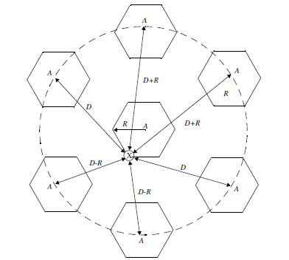
Illustration of the first tier of co-channel cells

Slide 12


In terms of the co-channel reuse ratio Q
Worst case S/I for the example =49.56=17
Less than 18dB

Slide 13
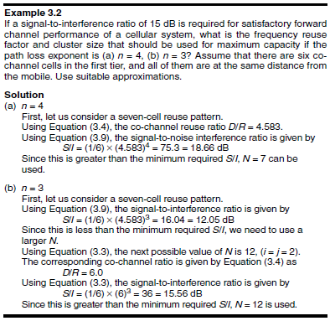

Slide 14
Channel Planning
Typically, about 5% of the entire mobile spectrum is devoted to control channels.
Control channels are generally not allowed to be used as voice channels, and vice versa.
Frequency reuse strategy applied to control channels is different and generally more conservative.
Need more care in CDMA.

Slide 15
Adjacent Channel Interference
Interference resulting from signals which are adjacent in frequency to the desired signal.
Results from imperfect receiver filters.
Near Far effect
Particularly severe when the mobile is far away from its BS and very near to an adjacent channel transmitter.
Also happens when a mobile close to BS uses a channel which is adjacent to a very weak mobile transmitting to the same BS

Slide 16
ACI can be reduced by careful filtering and frequency assignment
As a cell only has a fraction of channels, these channels do not have to be adjacent in frequency
ACI is reduced if we maximize the separation between adjacent channels in a cell
Power control of all mobiles
Under constant control by the serving base stations
Helps prolong battery life and reduces the reverse channel S/I in the system

Slide 17
Trunking
Trunking system : Accommodate a large number of users in a limited radio spectrum
Providing access to each user, on demand, from a pool of available channels.
When a particular user requests service and all of the radio channels are already in use,
The user is blocked, or denied access to the system.
A queue may be used to hold the requesting users until a channel becomes available.

Slide 18
Terms Used in Trunking
Set-up Time : The time required to allocate a radio channel to a user.
Blocked Call : Call which can’t be completed at time of request, due to congestion.
Holding Time: Average duration of a typical call. Denoted by H (in second).
Traffic Intensity: Measure of channel time utilization, which is the average channel occupancy measured in Erlangs.
This is a dimensionless quantity and may be used to measure the time utilization of single or multiple channels. Denoted by A

Slide 19
Contnd..
Load: Traffic intensity across the entire trunked radio system, measured in Erlangs.
Grade of Service(GOS): A measure of congestion which is specified as the probability of a call being blocked (Erlang B), or the probability of a call being delayed beyond a certain amount of time (Erlang C).
Request Rate: The average number of call requests per unit time. Denoted by μ second⁻¹

Slide 20
Grade of Service(GOS)
Measure of the ability of a user to access a trunked system during the busiest hour.
A benchmark used to define the desired performance of a particular trunked system.
GOS is typically given as the likelihood that a
Call is blocked,
Call experiencing a delay greater than a certain queuing time.

Slide 21
Computation of GOS
The traffic intensity offered by each user;
Au=λH
λ: average number of call request per unit time for each user.
H: average duration of a call.
A system containing U users and an unspecified number of channels; the total offered traffic intensity;
A=UAu
In a C channel trunked system, if the traffic is equally distributed among the channels, then the traffic intensity per channel;
Ac=UAu/C

Slide 22
Types of Trunked systems
Blocked calls cleared - No queuing for call requests:
For every user who requests service, it is assumed there is no setup time and the user is given immediate access to a channel if one is available.
If no channels are available, the requesting user is blocked without access and is free to try again later.
GOS: Erlang B formula determines the probability that a call is blocked.
Blocked calls delayed - A queue is provided.
If a channel is not available immediately, the call request may be delayed until a channel becomes available.
GOS: Erlang C formula gives the likelihood that a call is initially denied access to the system

Slide 23
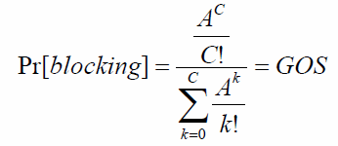
Blocked Calls Cleared
Blocking Probability -- Erlang B Formula:
C = Number of Trunked channels
A = Total offered traffic
K = Channels in use
Assumed to be
There are infinite number of users.
Call requests are memoryless; both new and blocked users may request a channel at any time.
Service time of a user is exponentially distributed
Traffic requests are described by Poisson model.
Inter-arrival times of call requests are independent and exponentially distributed.

Slide 24
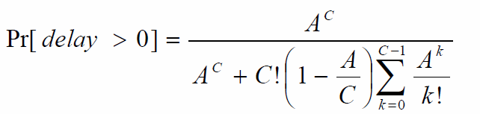
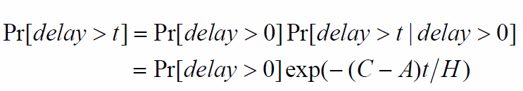
Blocked Calls Delayed
Erlang C Formula – the likelihood of a call is initially denied to access a channel:

Slide 25

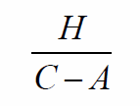
The average delay D for all calls in a queued system is given by:
The average delay for those calls which are queued is given by:

Slide 26
Trunking Efficiency
A measure of the number of users which can be offered a particular GOS with a particular configuration of fixed channels.
The way in which channels are grouped can substantially alter the number of users handled by a trunked system.

Slide 27
Improving Capacity in Cellular Systems
Adding New Channels
Frequency borrowing
Change of Cell Pattern
Cell Splitting
Sectoring
Repeaters for Range Extension
Coverage zone

Slide 28
Cell Splitting
The process of subdividing a congested cell into smaller cells,
With its own base station
With a corresponding reduction in antenna height and transmitter power.
Cell splitting (smaller microcells) is usually done on demand.
The co-channel reuse ratio D/R kept unchanged

Slide 29
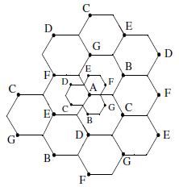
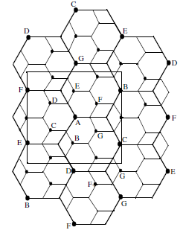
Cell Splitting

Slide 30
Contnd..
Ensure that the frequency reuse plan for the new microcells behaves exactly as for the original cells.
Splitting process continues until all the channels in an area are used in the lower power group.
Antenna downtilting, which deliberately focuses radiated energy from the base station toward the ground, is often used to limit the radio coverage of newly formed microcells.

Slide 31
Cell Splitting Drawbacks
In practice not all cells are split simultaneously, therefore we may have cells of different sizes.
Also the handoff between the cells and microcells has to be taken care off so that high speed and low speed mobiles are equally served.
Decreasing cell size results in more handoffs per call and higher processing load per subscriber. Thus, the handoff rate will increase exponentially

Slide 32
Sectoring
The technique for decreasing co-channel interference and thus increasing system capacity by using directional antennas.
The co-channel interference in a cellular system may be decreased by replacing a single omnidirectional antenna at the base station by several directional antennas, each radiating within a specified sector.
The cell radius kept unchanged.
The D/R ratio is decreased.

Slide 33
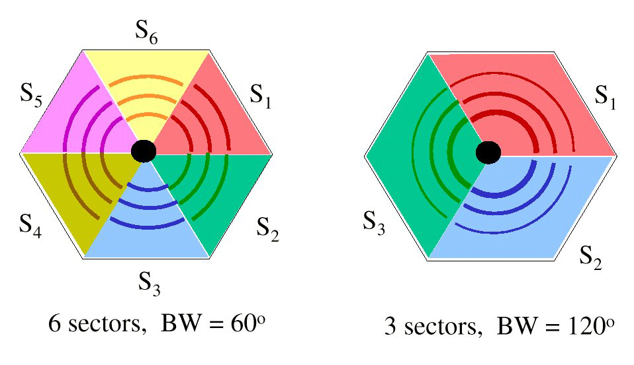
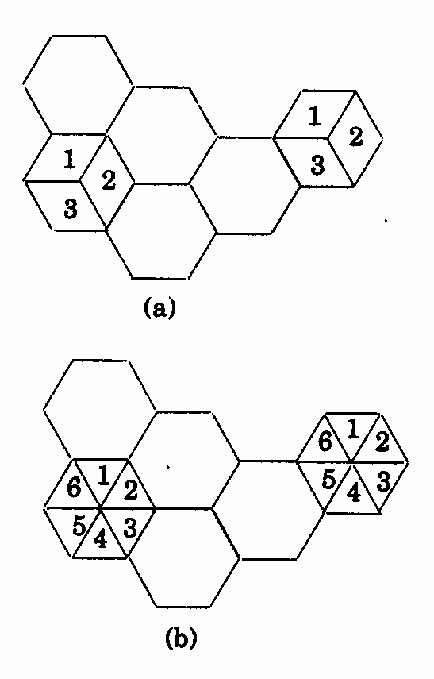

Slide 34
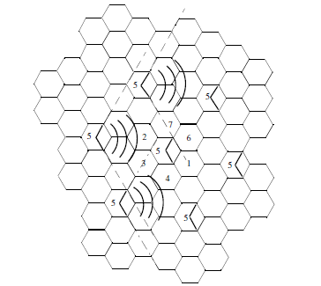
Reduction of interference from co-channel cells

Slide 35
Drawback
Sectoring uses more than one antenna per base station,
The available channels in the cell must be subdivided and dedicated to a specific antenna.
This breaks up the available trunked channel pool into several smaller pools.
Decreases trunking efficiency.

Slide 36
Repeaters for Range Extension
Repeater does not add capacity to the system.
It simply serves to reradiate the base station signal into specific locations.
Repeaters are bidirectional in nature, and simultaneously send signals to and receive signals from a serving base station.
May be installed anywhere and are capable of repeating an entire cellular or PCS band.
Upon receiving signals from a base station forward link,
Amplifies and reradiates the base station signals to the specific coverage region.
Unfortunately, the received noise and interference is also reradiated.

Slide 37
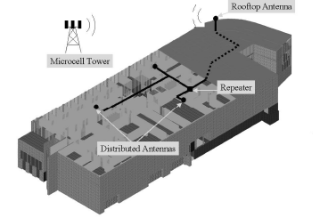
Distributed Antenna System (DAS)

Slide 38
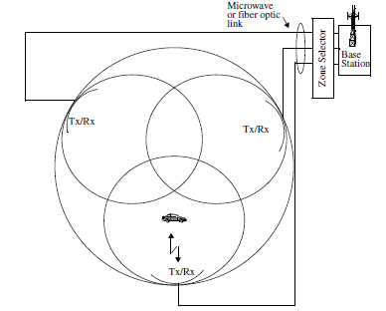
A Microcell Zone Concept

Slide 39
A Microcell Zone
Multiple zones and a single base station make up a cell.
Zone sites are connected to a single base station and share the same radio equipment.
The zones are connected by coaxial cable, fiberoptic cable, or microwave link to the base station.
Antennas are placed at the outer edges of the cell.
Any base station channel may be assigned to any zone by the base station.

Slide 40
A Microcell Zone
A given channel is active only in the particular zone
The channels are distributed in time and space by all three zones and are also reused in co-channel cells in the normal fashion.
Co-channel interference in the cellular system is reduced
Since a large central base station is replaced by several lower powered transmitters (zone transmitters) on the edges of the cell.

Slide 41
For the same S/I requirement, this system provides a significant increase in signal quality and capacity.
No degradation in trunking efficiency.

Slide 42
